Slide 1

Hotel Management System Database
Presented by
يوسف محمد عبدالتواب
عبدالله محمد أبوالفتوح
مروان خالد محمد
عبدالقادر محمد عبدالقادر

Slide 2
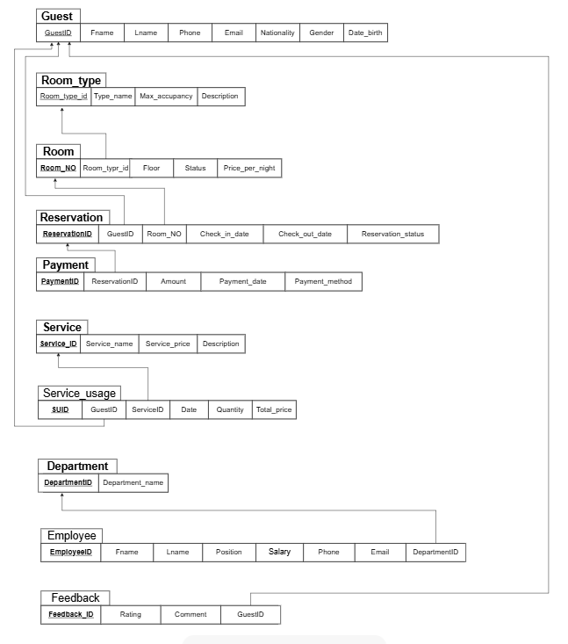
entities
The following table illustrates the basic entities in the system and some of their important features:

Slide 3
First notation
1) Guest — Reservation Guest
(1) —— (M) Reservation Meaning: • One guest can have many reservations. • Each reservation belongs to exactly one guest.
2) Room — Reservation Room
(1) —— (M) Reservation Meaning: • A room can be reserved many times (different dates). • A reservation uses one room.

Slide 4
First notation
3) Room_Type — Room Room_Type (1) —— (M) Room Meaning: • One room type (single/double/etc.) applies to many rooms. • Each room belongs to exactly one room type.
4) Reservation — Payment Reservation (1) —— (1) Payment (Based on your design: one payment per reservation) Meaning: • Each reservation has one payment entry. • Each payment corresponds to one reservation.

Slide 5
First notation
5) Guest — Feedback Guest
(1) —— (M) Feedback Meaning: • One guest may write many feedback entries. • Each feedback belongs to one guest.
6) Service — Service_Usage Service
(1) —— (M) Service_Usage Meaning: • A service can be used multiple times. • Each usage record represents one specific service used by one guest.

Slide 6
First notation
7) Guest — Service_Usage Guest
(1) —— (M) Service_Usage Meaning: • A guest can use multiple services. • Each usage record belongs to one guest.
8) Department — Employees Department (1) —— (M) Employee Meaning: • One department contains many employees. • Each employee belongs to one department.

Slide 7
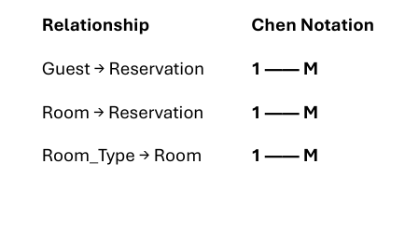
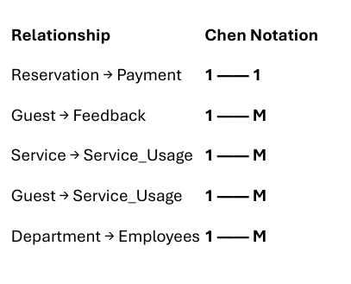
Final Summary (Only Chen Notation)

Slide 8
Min and max
1) Guest — Reservation Guest
(1,1) —— (0,N) Reservation Meaning: • A reservation must belong to exactly one guest → (1,1) • A guest may have zero or many reservations → (0,N)
2) Room — Reservation Room
(1,1) —— (0,N) Reservation Meaning: • A reservation must be tied to exactly one room → (1,1) • A room can have zero or many reservations over
time → (0,N)

Slide 9
Min and max
3) Room_Type — Room Room_Type
(1,1) —— (1,N) Room Meaning: • Every room must belong to one room type → (1,1)
• A room type must have at least one
room → (1,N) (Unless hotel defines unused types — but we assume design requires at least one room.)
4) Reservation — Payment Reservation
(1,1) —— (0,1) Payment Meaning:
• A reservation must have exactly one associated record in your schema? Actually your design allows: Payment table:
reservationID (FK) → NOT required to be unique But logically: one reservation → one payment So: • A reservation may have zero or one payment → (0,1) • A payment must belong to one reservation → (1,1) So the relationship is: Reservation (0,1) —— (1,1) Payment

Slide 10
Min and max
5) Guest — Feedback Guest
(1,1) —— (0,N) Feedback Meaning: • A feedback entry must belong to a
guest → (1,1) • A guest may leave zero or many feedbacks → (0,N)
6) Service — Service_Usage Service (1,1) —— (0,N) Service_Usage • Each service usage line must refer to one service → (1,1) • A service can be used many times → (0,N)

Slide 11
Min and max
7) Guest — Service_Usage Guest
(1,1) —— (0,N) Service_Usage Meaning: • A service usage must belong to one guest → (1,1) • A guest can have zero or many service usage records → (0,N)
8) Department — Employees Department (1,1) —— (0,N) Employees Meaning: • Each employee must belong to one department → (1,1) • A department can have zero or many employees → (0,N)

Slide 12
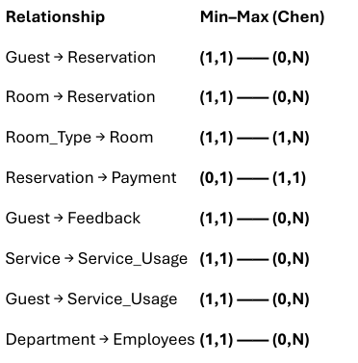
Full Summary Table (Min, Max)

Slide 13
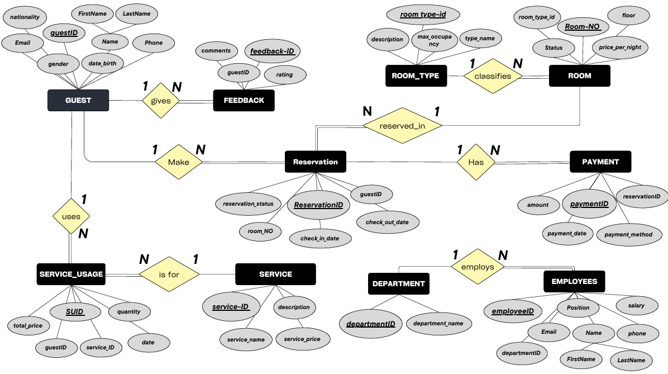

Slide 14
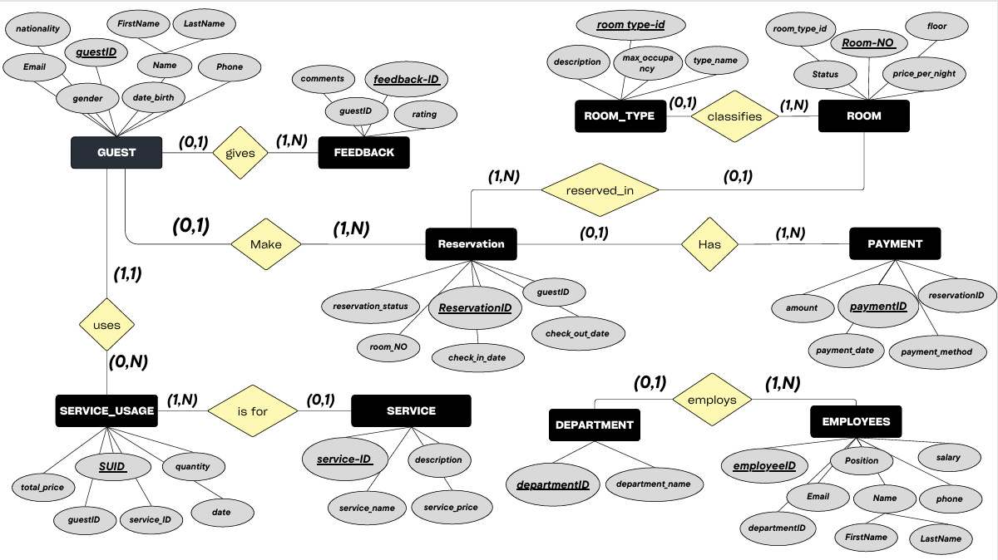

Slide 15


